Slide 1
Skin Cancer Detection with 3D-TBP
Kaggle Competition: ISIC 2024
Matthew Huang, Justin Koida, and Joenna Yaya

Slide 2
Context

Slide 3
Skin Cancer
3 Major Types:
Basal Cell Carcinoma
Squamous Cell Carcinoma,
Melanoma (1)
Caused by UV rays from the sun/tanning beds (1)
Skin Lesions are areas of skin that look different from surrounding skin. They are either benign (non-cancerous) or malignant (cancerous). (2)

Slide 4
AI and Skin Cancer Diagnosis
Kaggle competition via ISIC: International Skin Imaging Collaboration
What data was provided to us?
.jpeg Images
.csv Sheets
target: 0 for benign, 1 malignant
meta-info on lesion size, symmetry, color data, body location, etc.
Goal: Classify skin lesions as benign or malignant.

Slide 5
Our Project
Design simple CNNs, train and evaluate them with the competition data
Analyze competitors’ submissions
Compare different models and methods

Slide 6
The Data

Slide 7
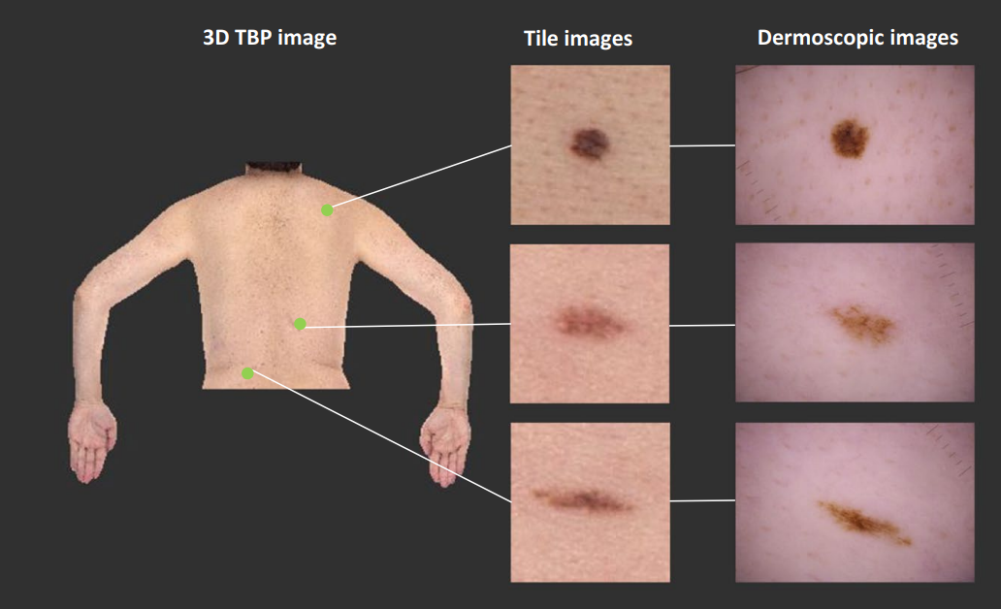
The SLICE-3d Dataset
Over 400,000 images of skin lesions extracted from 3D Total Body Picture (TBP).
Contributed by members of the International Skin Imaging Collaboration (ISIC).
Fig. 1

Slide 8
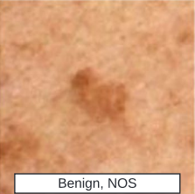
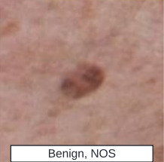
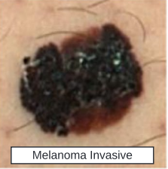
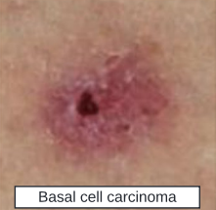
Image Data
Meta-Data
Corresponding Features:
Patient age
Lesion area
Body Location
Etc.
Fig. 2a-c

Slide 9
Pre-processing for Meta-Data
Filling Missing Values
Dropping detrimental features
Normalizing Quantitative Data
One Hot Encoding Categorical Data

Slide 10
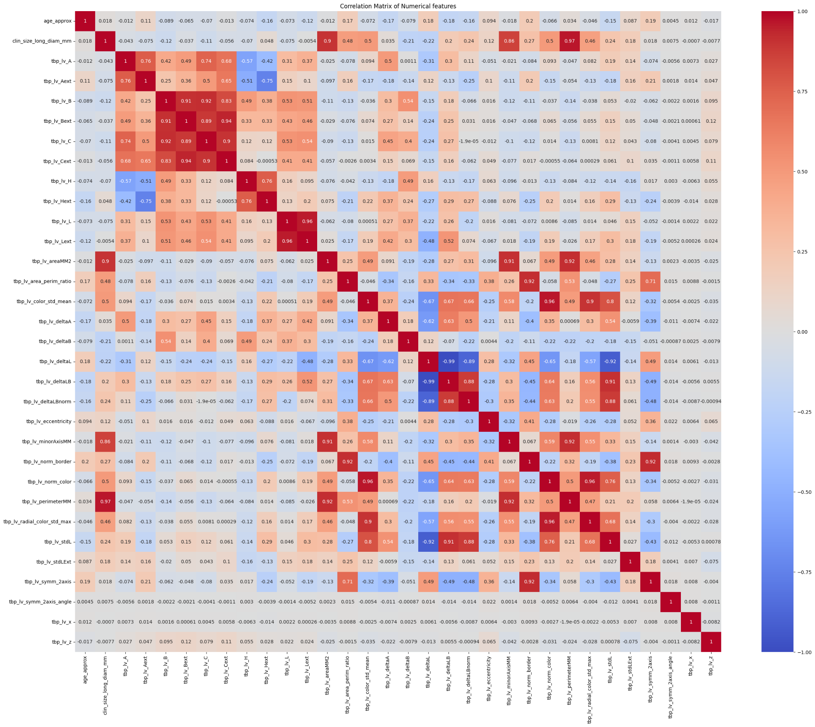
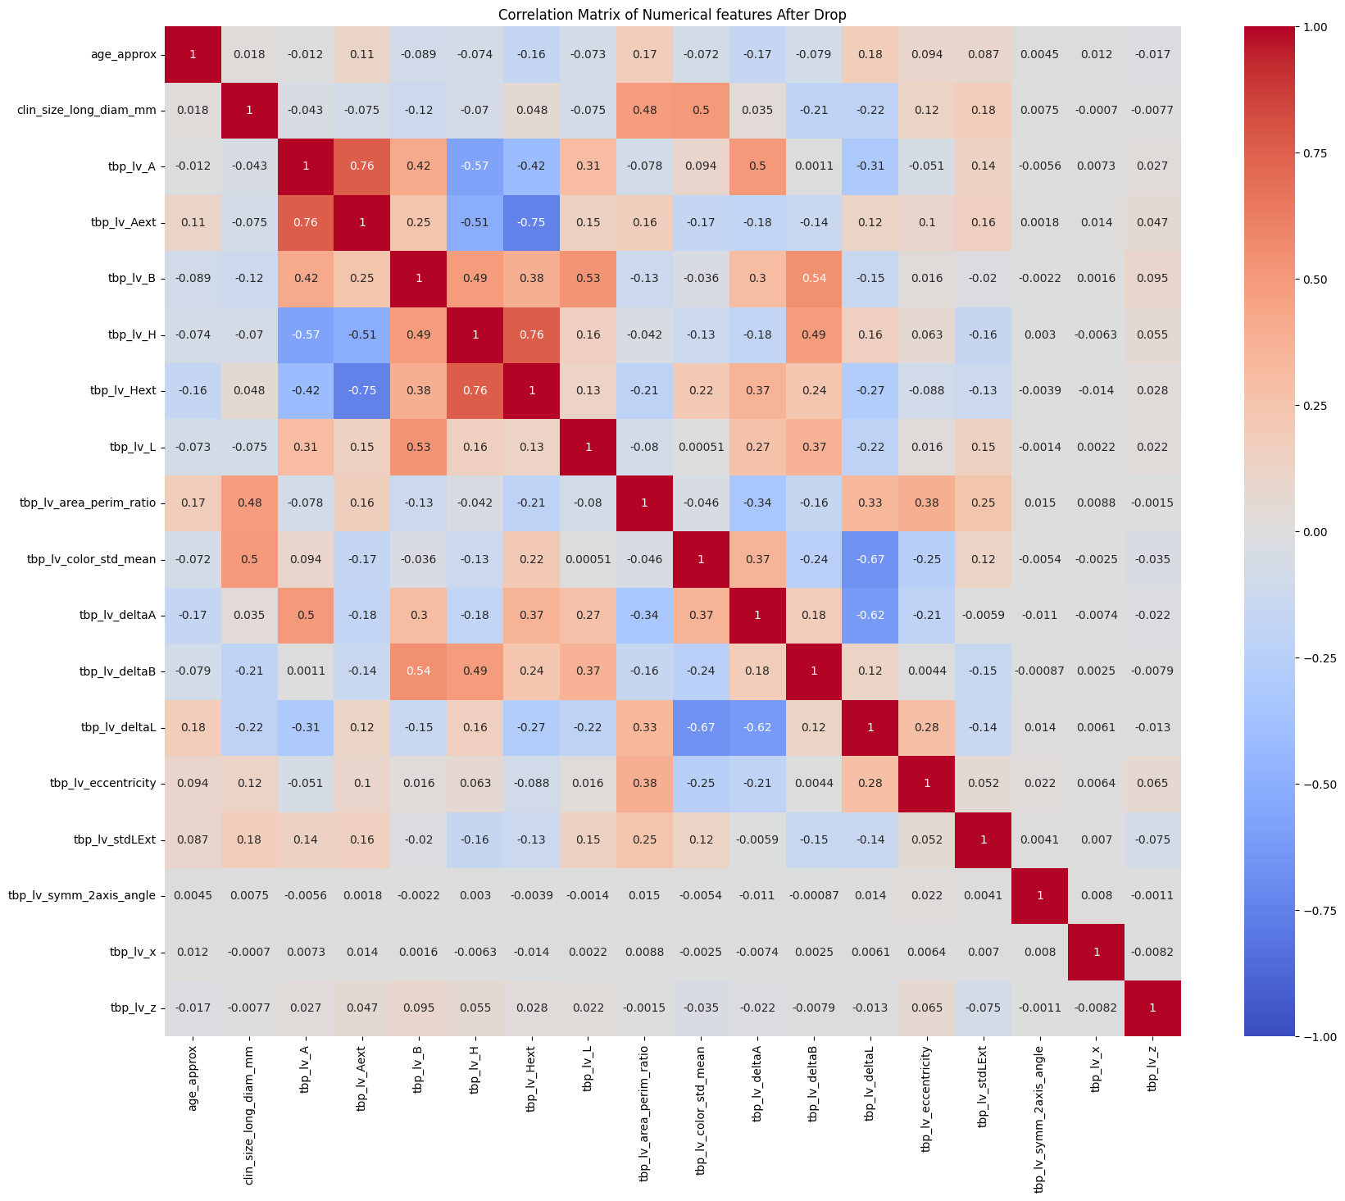
Reducing Collinearity
Fig. 3b
Fig. 3a

Slide 11
Predicting from Meta-Data

Slide 12
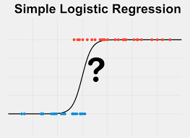
Logistic Regression
Created Logistic Regression class in PyTorch
Experimented with different loss functions
Implemented class balancing techniques
Fig. 4

Slide 13
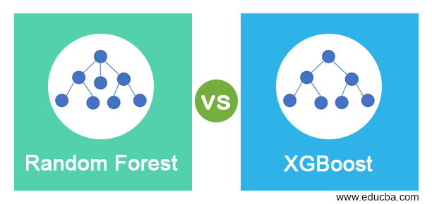
Random Forest Classifier and XGBoost
Fig. 5

Slide 14
Predicting from
Image Data

Slide 15

SimpleCNN()
Image→ Convolution→ Pool→ Convolution→ Pool→ FC → (Benign, Malignant)
128x128 2x1
Fig. 6

Slide 16
BiggerCNN()
Resnet18()
12 layers, 17 million parameters
Additions
Batchnorm
Dropout layers
18 layers, 11 million parameters
Additions
Batchnorm
Dropout Layers
Residual Connections

Slide 17
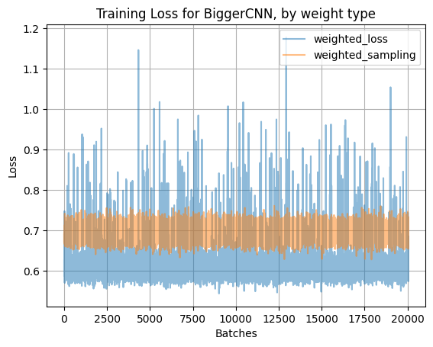
Problem: Data Imbalance
Benign:Malignant ratio is
~1000:1
To prevent models from only predicting Benign, during training we tried weighing
the loss: increase penalty for missing Malignant
the sampling: oversample Malignant, undersample Benign
Weighted Sampling is much more stable

Slide 18
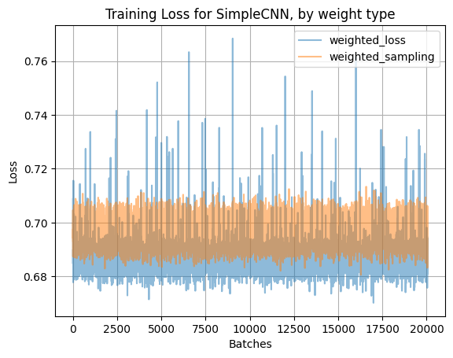
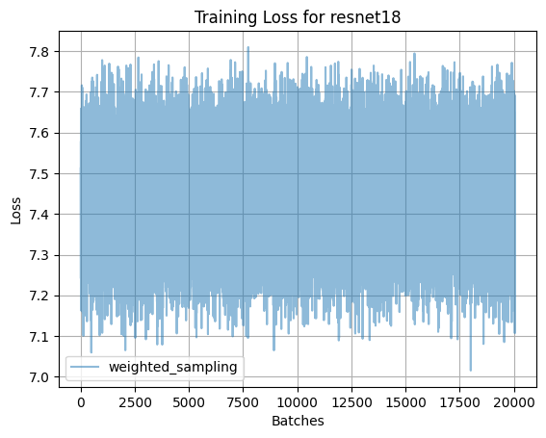
Problem: No Downward Trend

Slide 19
Results: Not Great

Slide 20
Results
 | Logistic Regression | Random Forest | XGBoost | SimpleCNN | BiggerCNN | Resnet18
Unweighted | P: 0% R: 0% | P: 0% R: 0% |  | P: 0% R: 0%
Weighted Loss | P: 0.25% R: 89% | P: 18% R: 3% | P: 2% R: 64% | P: 0% R: 0% | P: 0% R: 1%
Weighted Sampling |  |  |  | P: 0.25% R: 68% | P: 3.9% R: 11% | P: 8% R: 2.67%
P: Precision of Malignant Class, the proportion of predicted malignants which are actually malignant.
R: Recall of the Malignant Class, the proportion of true malignant cases found.

Slide 21
Thanks!

Slide 22
References
(1) The Skin Cancer Foundation (2024, February 1). Defining Skin Cancer. Skin Cancer Foundation. https://www.skincancer.org/blog/defining-skin-cancer/
(2) The Skin Cancer Foundation. (2024 July). Skin Cancer 101. Skin Cancer Foundation. https://www.skincancer.org/skin-cancer-information/
(3) Nicholas Kurtansky, Veronica Rotemberg, Maura Gillis, Kivanc Kose, Walter Reade, Ashley Chow. (2024). ISIC 2024 - Skin Cancer Detection with 3D-TBP. Kaggle. https://kaggle.com/competitions/isic-2024-challenge
(Fig. 1) Kurtansky, et all. (2024). The SLICE-3D dataset: 400,000 skin lesion image crops extracted from 3D TBP for skin cancer detection. Scientific Data. 11. 10.1038/s41597-024-03743-w.
(Fig. 4) Simple Logistic Regression [Image]. (n.d.). In *Statstest.com*. Retrieved from https://www.statstest.com/simple-logistic-regression/
(Fig. 5) Random Forest vs XGBoost [Image]. (2021, August). In *EDUCBA*. Retrieved from https://cdn.educba.com/academy/wp-content/uploads/2021/08/Random-Forest-vs-XGBoost-1.jpg
(Fig. 6) A Guide to Convolutional Neural Networks — the ELI5 way | Saturn Cloud Blog. (2023, November 20). https://saturncloud.io/blog/a-comprehensive-guide-to-convolutional-neural-networks-the-eli5-way/

